Slide 1


dbt Kickoff Call
L'Oréal
Notes:
Attendees--
Fishtown: SA, SD
Customer: dbt project owner + technical owner at minimum, ideal to have the Exec buyer, but not a huge group

Slide 2
Agenda
Points of contact at L'Oréal
Onboarding Timelines
Communication
Goals
Resources
Next Steps
Notes:
Introductions of anyone new to the conversation on both sides (ie if we brought Scott or Jess on for more strategic customers) and making sure we have the right points of contact on your side as we get things underway
Set expectations around implementation and onboarding--both in terms of timelines and required steps
Share the communication paths during each phase
And align on your goals post implementation and onboarding

Slide 3

Introductions
Please share with us your name, role and pronouns

Slide 4
Points of Contact

Slide 5
Points of Contact
Project Leads
Project POC: Suryesh
Executive Sponsor: Christian
Deployment POC(s):
dbt Architecture POC:
Partners: LTI
Notes:
We’d like to define a couple of owners on your side:
dbt owner at [client] who I’ll work with to get things like account reviews, and our check in calls scheduled with--they’ll be my main point of contact.
Are you [name] also the point person for onboarding? If so I’ll introduce you to our onboarding team and share a list of to-dos that need to be done prior to onboarding kickoff.
Executive sponsor--who’s budget is this coming out of?
Deployment POC- this is the person or group i will connect our CSE team with (or have already connected our CSE team with!) to make sure that we get dbt set up properly to scale to your team
Internal note: if we already have this person, we should send that intro ASAP and fill in the person’s name here.
dbt Architecture POC- this is the long term technical owner of dbt--[SA] counterpart

Slide 6
How we work with you
Your Account Team
Solutions Architect
Sales Director
Pro-Serv
Support
Partner Network
You Need
To understand how to make dbt best practices work for your business & how to optimize your data stack
A collaborator to show the value dbt is providing you & your business
Help implementing a dbt solution in concert with your team, using your own data stack
Assistance for dbt Cloud users who hit hurdles while using the product
An extra pair of hands to implement a solution in your data stack
Helping Hands Will
Consult on project design, branching or materialization strategies, impactful macros; do a quick check of process & code for high-level issues; act as a product feedback champion
Work with you to highlight the return on your investment in dbt or explore if dbt is right for other problems you’re trying to solve
Co-develop with your team to provide code-based deliverables throughout your dbt-focused stack
Aid your team members via live chat or email to resolve issues encountered when using dbt Cloud
Produce custom development deliverables, provide API support, etc
How
Email & Calls
Email & Calls
Virtual meetings
Zendesk
via introduction

Slide 7
Timeline for Onboarding
Notes:
This piece should be run by the SA, the goal is to establish the types of topics they should be covering in the engagement

Slide 8
The dbt Cloud Onboarding Process
Data Stack Decisions
Rapid Onboarding
Onboarding Wrap Call
Kickoff
Setup
Make decisions about project setup, promotion strategy, access, etc.
We are here now! Let’s align on timeline & expectations
Meeting with your account team to confirm onboarding goals have been reached
Our Support team coaches you on how to connect your systems to dbt Cloud
dbt mindset; a query running in production with models and configurations set
Notes:
Today we’re at the kickoff call step, so let’s lay out what the next few weeks will look like. Throughout the entire process, you’ll always be able to reach out to your account team (me and [SA name]) or enter a support ticket. For different phases onboarding you’ll be working mostly with our Customer Success team.
You may have already heard from a member of our support team, a customer success specialist! They will be using Zendesk to reach out, so if you do not hear from them in the next day search your inbox please. Their goal is to help make sure your systems get connected with dbt Cloud properly. We set a budget of 7 days for setup.
We will also be introducing you to our rapid onboarding coordinator to schedule the 6 week training on modeling, testing, documentation. After those 6 weeks are up we want to make sure everything working as desired so we’ll have a check-in call to officially end onboarding. I want to call out the data stack decisions stage of this journey. We are always happy to make recommendations on what makes sense for your organization but this is ultimately your choice. It is really important to make these decisions before you kickoff rapid onboarding. If for some reason you don’t think you’ll have time to implement these, let’s talk about getting our professional services team involved or one of our partners who can make implement these.

Slide 9
Rapid Onboarding Tasks and Timeline
To kick off dbt Rapid Onboarding, 6 weeks
dbt Cloud Setup needs to be complete for course to begin
You will provide dbt Labs facilitators a dbt project and SQL query as the working base for your team
Course includes
5-8 dbt power users trained in your environment
End state is 2 models built in the “dbt way”
Six, 90-minute synchronous sessions with 1.5-2 hours of video instruction in between
Notes:
The foundations of the Rapid Onboarding course is that you’ll be using your data in your project to build a “dbt best practices” example, which can then be used as a guide as you continue to build out your project. Our trainers use a nested or complex SQL query (provided by you), and break it into all the different pieces that comprise a dbt project. Since it’s so helpful for you to use your own SQL query and data so your team can connect and internalize the architecture that dbt provides, rather than spending mental energy learning new datasets and their nuances, our ask is to think about what you want that to be. Your facilitator will reach out to you before starting and you can also have that discussion with them.

Slide 10
dbt Rapid Onboarding Topics by Session
Session | Focus
1 | Discussion around current infrastructure and any planned changes Walkthrough of an exemplar dbt project Begin migration of existing transformation code OR begin building initial model code for the project
2 | Complete the migration of transformation code OR building initial model code
3 | Ensure all models have primary keys Apply testing for all models and sources built in previous sessions
4 | Write documentation for the models and sources built in previous sessions Configure dbt to run on a schedule with in the deployment environment with best practices
5 | Start drafting key documents to support future data team collaboration including a readme, style guide
6 | Finalize the initial version of the dbt project including models, tests, documentation, and key documents.
Notes:
Each session is broken down by topic--at the end of the rapid onboarding you’ll have 2 models in your dbt account in “the dbt way” that will help establish best practices and good habits going forward.

Slide 11
Communication
Notes:
Now I’d like to talk about communication channels for different topics and how often we meet post-onboarding.

Slide 12
Communication
Support Channels
Email - support@getdbt.com
Zendesk / Chat (Direct Technical Support)
Best for questions like…
“How do I set up a dbt Cloud Project?”
“Help I can’t log in!”
“Something isn’t working the way I would expect it to in a macro I created/I need help troubleshooting this error.”
Notes:
We should be verbally talking through the *types* of questions that Support handles vs the types of questions they should contact their account team with (all laid out in our docs here: https://docs.getdbt.com/docs/dbt-cloud/cloud-dbt-cloud-support)
The goal here is to ensure that they know that reaching out to their SA/SD is *not* the quickest resolution path for technical questions.

Slide 13
Communication
Beyond Onboarding
Ongoing Check-ins with Account Team
Weekly Meeting for Month 1
Every other week meeting for Months 2 and 3
Monthly meeting for months 3 and beyond
Quarterly Account Usage review
Notes:
SD should modify this slide as needed in terms of check-ins to align with the timeline on slide 4

Slide 14
Goals
Notes:
This piece should be run by the SA, the goal is to establish the types of topics they should be covering in the engagement

Slide 15
Goals beyond Onboarding
What does success look like after implementing dbt?
First 2 projects (rebuild will take ~2 years)
SAP -> Success Factors reporting (PowerBI) HR Data Platform
Project 1: Learning: Employee Training
Project 2: Performance Management
Licensing could grow over time when they start to parallelise
Develop a quarterly check-in cadence
Ernesto to schedule for end of September
Decide / Document dbt Architecture
Session possibly next week on Auditing
Ernesto to ask Rebecca about non-refactored but green

Slide 16
Learning Resources
Notes:
This piece should be run by the SA, the goal is to establish the types of topics they should be covering in the engagement

Slide 17
Resources
Community
13,000+ members with opinionated responses to questions like “What is the best approach to X?”
Join the #beginners, #modeling and #dbt-cloud channels!
Discourse
Shared learnings like “How we structure our dbt projects” and “How to create near real time models with dbt + SQL”
dbt Cloud Status Page (for multi tenant customers only)
Subscribe to this for updates!

Slide 18
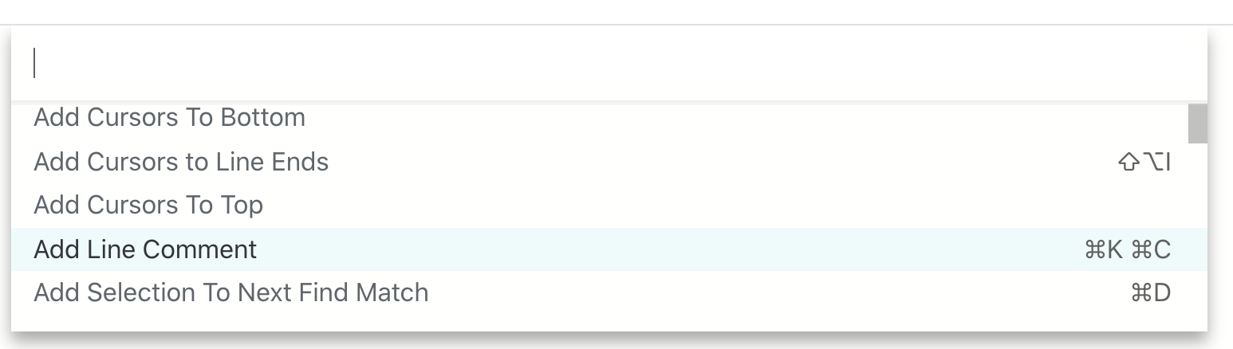
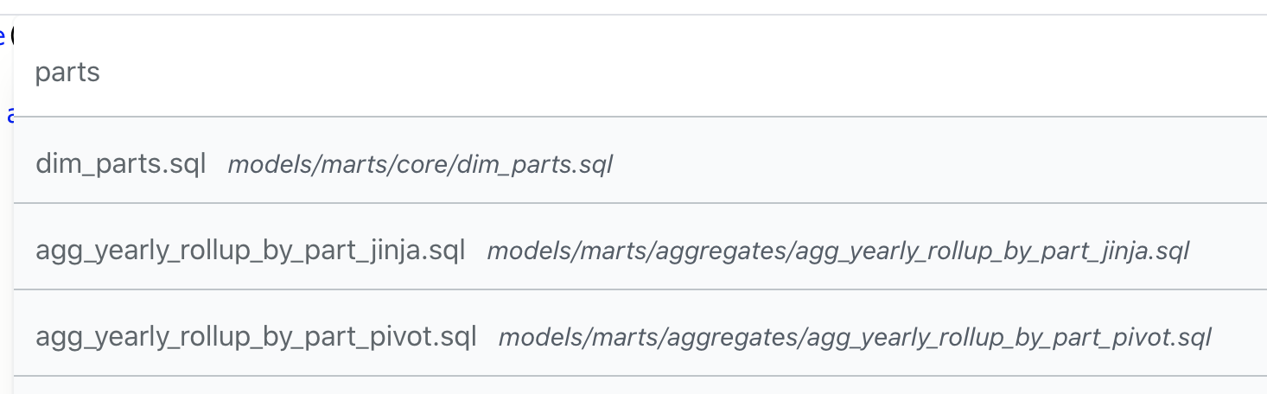
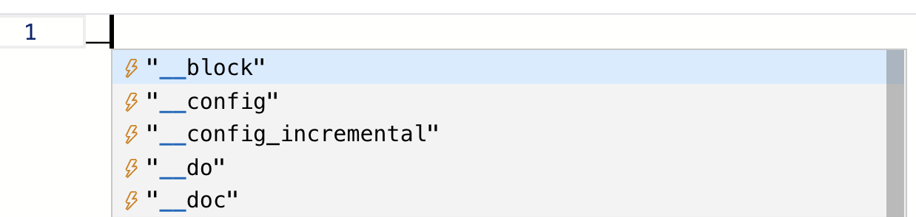
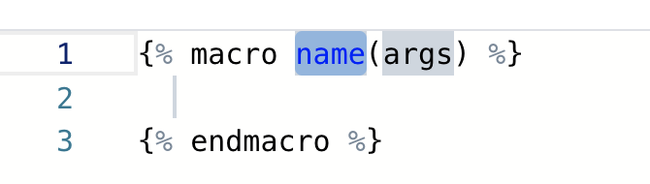
Useful Keyboard Shortcuts
F1 command menu
CTRL-O Find & open files by name
__ (underscore underscore) Selected code templates

Slide 19
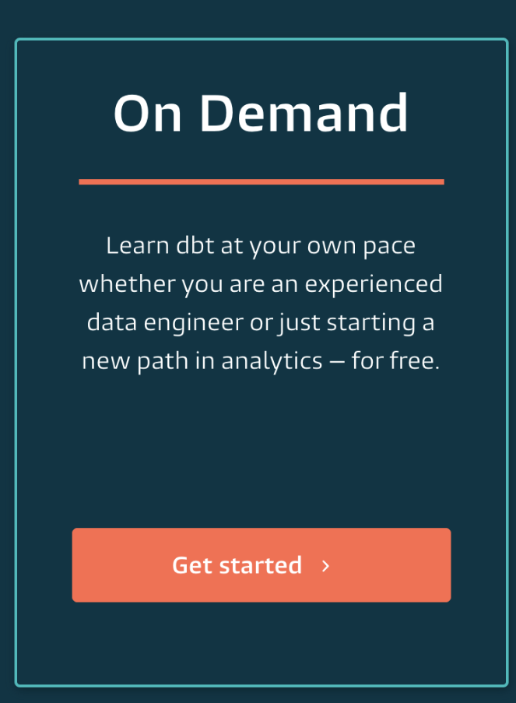
Suggested starters for new dbt team
“How do I get started?”
dbt 101 - “What is dbt”
30 min intro to SQL transforms, lineage, documentation testing
https://www.youtube.com/watch?v=M8oi7nSaWps
dbt Fundamentals - on-demand
self paced online learning
https://learn.getdbt.com/
New to version control? (though, dbt Cloud helps make this easier)
Concepts: https://dev.to/unseenwizzard/learn-git-concepts-not-commands-4gjc
Workflow: https://www.atlassian.com/git/tutorials/comparing-workflows/gitflow-workflow
Reference Docs:
dbt Cloud docs https://docs.getdbt.com/docs/dbt-cloud/cloud-overview
dbt General docs https://docs.getdbt.com/docs/introduction

Slide 20

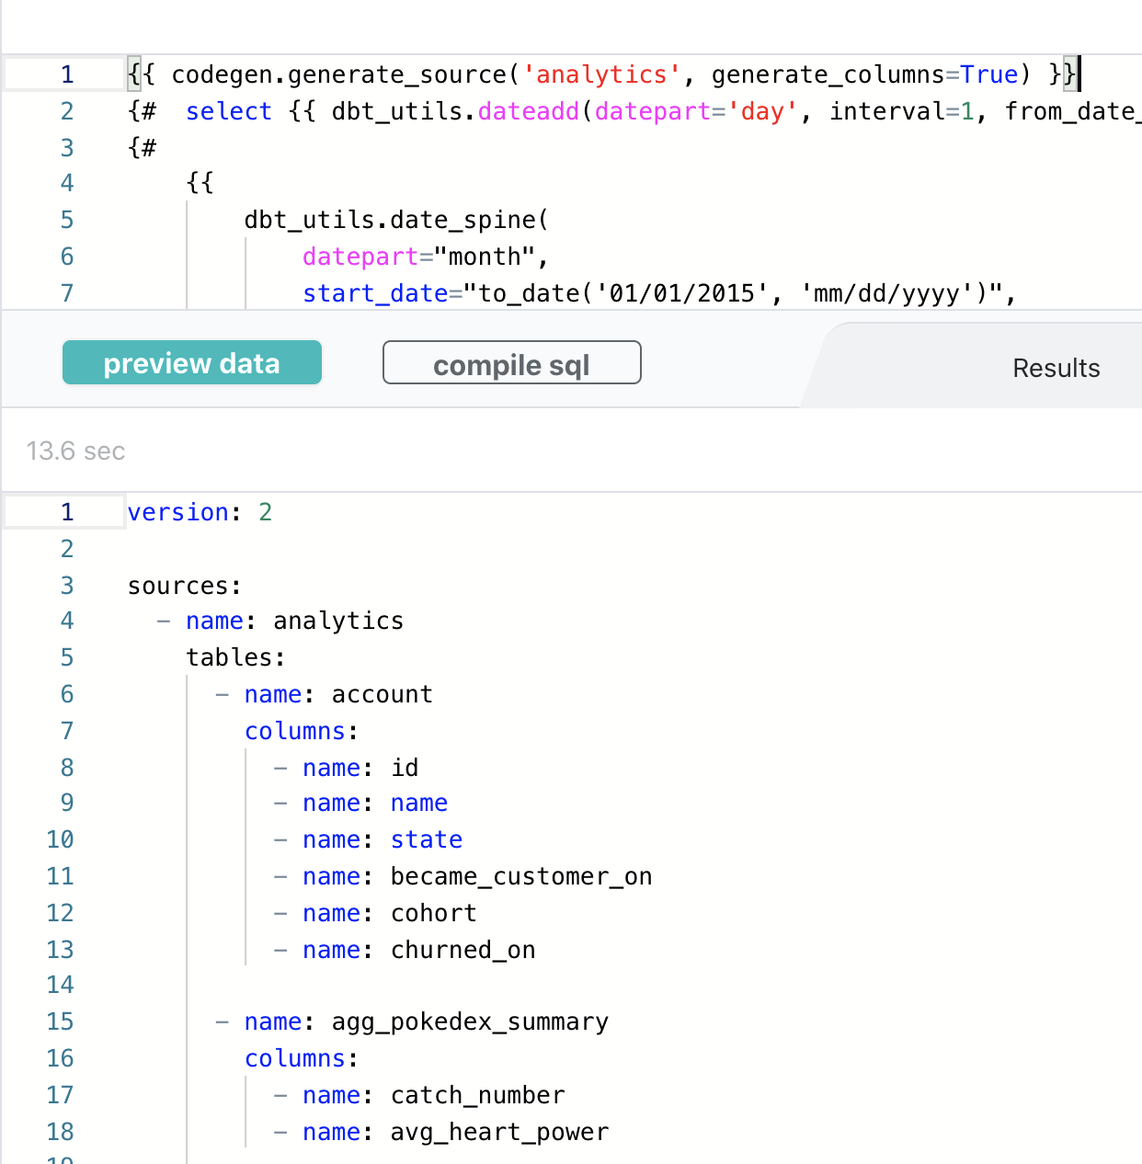
demo
dbt Packages I love
dbt_utils
macros that can be (re)used across dbt projects
codegen
auto generated your sources
audit_helper
helps you compare data

Slide 21
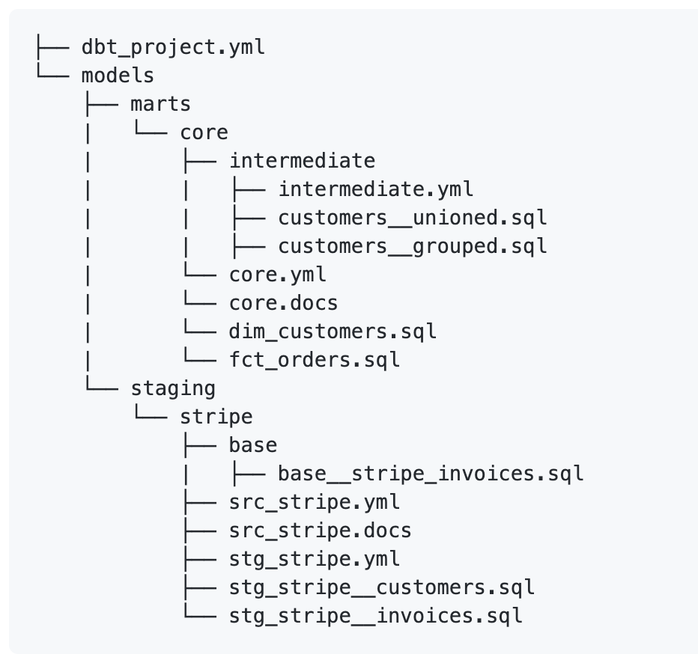
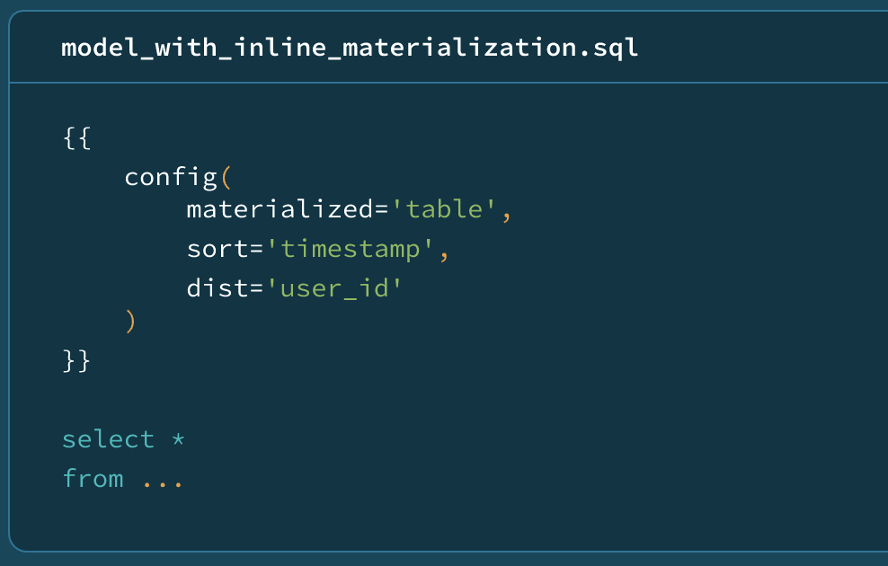
Going deeper
“How do I learn more about best practices?”
dbt Project Structure
General guidelines / conventions Fishtown have developed
https://discourse.getdbt.com/t/how-we-structure-our-dbt-projects/355
dbt Style, Coding and Project Guide
https://github.com/fishtown-analytics/corp/blob/master/dbt_coding_conventions.md
Follow on: what are CTE’s, why does dbt use recommend them https://discourse.getdbt.com/t/why-the-fishtown-sql-style-guide-uses-so-many-ctes/1091
What does dbt always mention idempotence?
Running a transform once produces the same result as running it multiple times.
https://discourse.getdbt.com/t/understanding-idempotent-data-transformations/518
How we structure our Data Warehouse Permissions
May be most relevant reading for DB admins
https://discourse.getdbt.com/t/the-exact-privileges-we-grant-outside-of-dbt/439

Slide 22
Project Review (17 August)
Notes:
This piece should be run by the SA, the goal is to establish the types of topics they should be covering in the engagement

Slide 23
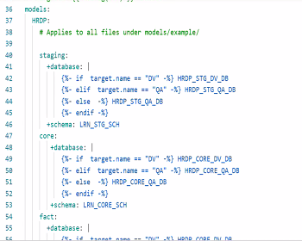
Snowflake on GCP
Raw files on GCP bucket
Using SSO
Github
Setup with git not with https
HRDP_LRN - Learning
4 Environments:
Dev - they are not doing their own development environment
QA
UAT
Prod
Folder Structure
Starts with Cloud Composer (aka Airflow) (GCP -> Landing Layer)
Suggestion: you could use dbt _external_tables
Staging - not doing renaming of columns or removing them
They are using Landing and Staging standardized names. They feel their way works better for them, they want to select all to keep historical

Slide 24
Jobs
Airflow/Composer - triggers QA ->
How does code promotion work?
After committing -> CI/CD automatically runs into QA for every single Commit
Recommend: move to pull-requests and fewer environments
They have to have 4 environments, currently all commits auto build inside QA -> then PR
Q: wants to use sequence - currently using surrogate_key - and running into limitations
LTI team will share question via email, generally my recommendation is to use hashing functions because they are deterministic, meaning the same set of inputs will always produce the same output. Building with dbt works best when all parts of your project are idempotent, and hashed keys require close to zero maintenance.

